Slide 1
PERIODIC CLASSIFICATION OF ELEMENTS PART-3 : THE MODERN PERIODIC TABLE
CHAPTER 5

Slide 2
Modern Periodic Table
Classification criteria is the atomic number of the elements
Notes:
Slide: 16
Welcome back.
In this video, we will be discussing about the modern periodic table which is currently in use.
In the previous videos, we saw that the foundation of the tables was the atomic mass. But in the modern periodic table, the base is the atomic number. The prediction of properties of elements was made easier when they were arranged according to their atomic numbers instead of their atomic mass.

Slide 3
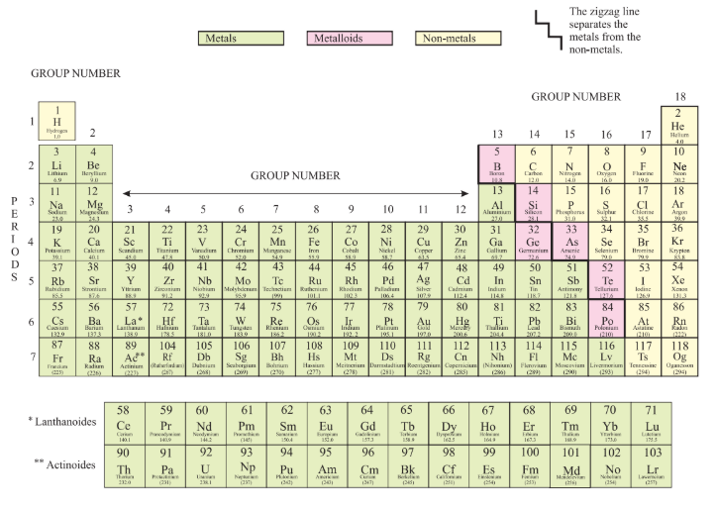
Position of Elements in Periodic Table
Notes:
Slide: 17
In the modern periodic table, the columns are called ‘Groups’ and the rows are called ‘Periods’.
There are 18 groups and 7 periods in the table.
If you notice, elements belonging to a particular group contain the same number of valance electrons.
Let us go back to our previous classes and recollect what valence electrons are. The electrons that are present in the outermost shell of an atom are known as valence electrons.
For example, consider Group 17.
The number of valence electrons of Florine (F) (point out fluorine) is 7.
Similarly, if you look at the number of valence electrons of Chlorine (Cl) (point out at chlorine), it is also 7. Likewise, every element of this group has a valency number of 7.
Also note that the number of shells increase per element, as we go down the group.
When the group contains the same number of valency electrons, the periods contain the same number of shells.
If you notice, the atomic numbers of elements increase from left to right in a period.

Slide 4
Elements in Periods
Maximum number of elements a shell can accommodate is 2n²
For example,
For Shell, K,
n=1
Maximum number of elements in K = 2x(1)² = 2x1= 2
For Shell, L,
n=2
Maximum number of elements in L = 2x(2)² = 2x4 = 8
Notes:
Slide: 18
Now, let us discuss how the periods are filled with elements. If you recall, we can calculate the maximum number of electrons that can be accommodated in a shell can be calculated using the formula 2n², where, n is the number given to the shell from the nucleus.
For example, to calculate the maximum number of electrons in shell K, the first shell from the nucleus, we use 2n²
As K is the first shell, the n value will be one
So, the maximum number of electrons in K shell would be
2x(1)² = 2x1= 2.
Thus, the K shell can hold a maximum of two electrons and the first period of the modern periodic table constitutes of only two elements.
Similarly. For the L shell, the maximum number of electrons would be,
2x(2)² = 2x4 = 8.
Thus, the L shell can hold only 8 electrons and the second period of the modern periodic table constitutes of only 8 elements.
This is the pattern that was followed to put elements into the periods.

Slide 5
Trends in Modern Periodic Table
Valency
Atomic Size
Decreases from left to right
Notes:
Slide: 19
A few trends in the modern periodic table include valency and atomic size.
As we mentioned before, the valency of an element is the total number of electrons in the outermost shell of an atom. We are not going to go into the details of it as it was already explained before.
The distance between the center of the nucleus of an atom, to the outermost shell is known as atomic size. For hydrogen atom, the atomic radius is 10⁻¹² m.
In a period, the atomic size decreases from left to right.
This is because of the increase of nuclear charge of atoms and it pulls the electrons from the outermost orbits closer.
In a group, the atomic size increases as more shells are added to the atoms, which increases the distance between the nucleus and the outermost shell.

Slide 6
Metallic and Non-Metallic Properties
Metals lose electrons while forming bonds while non metals gain electrons.
Metallic charge decreases from left to right in a period and increases from top to bottom in a group
Oxides of metals are basic and that of non metals are acidic.
Notes:
Slide: 20
The metallic and non-metallic elements are separated by a zig zag line in the table. The metals are placed on the left of the line while the non-metals are placed on the right. The metals that are in pink are called semi-metals or metalloids as they are neither metals nor non-metals.
We know that metals tend to lose electrons when they are forming bonds and Non-metals gain electrons from other atoms to form a bond. In a Period, as we discussed before, the nuclear charge increases from left to right. Which implies that it is hard to lose electrons due to the nuclear pull. Thus, in a period, the metallic character decreases from left to right in a period.
Similarly, in a Groups, the nuclear charge decreases because of addition of shells. This makes it easy for the atoms to lose the electrons to form a bond. Thus, the metallic character increases from top to bottom in a group.
It should also be noted that the oxides of metals are basic and oxides of non-metals are acidic in nature.
With this, we conclude the topic, classification of elements

